Slide 1


Titolo presentazione sottotitolo
EMBEDDED SYSTEMS PROJECT
Milano, XX mese 20XX
Maitan, Medvedec, Megler, Paone

Slide 2
OUTLINE
INTRODUCTION
HARDWARE
GPIO
TIMER
INTERRUPT
SOFTWARE
DECODING
ENCRYPTING
ENCODING
TESTBENCH

Slide 3
INTRODUCTION
The project addresses the problem of encryption of a plain text in microcontroller based application.
The core of application is thus composed of three main tasks:
Acquire plain text in input
Generate cipher-text with the Caesar cipher
Display in output the outcome of the encryption

Slide 4
INTRODUCTION
The project addresses the problem of encryption of a plain text in microcontroller based application.
The core of application is thus composed of three main tasks:
Acquire plain text in input ➔ HARDWARE
Provide the Morse message using push-buttons on the board
Generate cipher-text with the Caesar cipher ➔ SOFTWARE
Display in output the outcome of the encryption ➔ HARDWARE
Output the cipher-text in Morse using LEDs

Slide 5
HARDWARE
GPIO:
We used the two GPIOs located on the board
GPIO_0 ➔ communicates with LEDs
GPIO_1 ➔ bound to the push-buttons
TIMER:
We used the systick timer to measure the time when a button pressure occurs in order to understand if a signal is long or short

Slide 6
HARDWARE
INTERRUPT:
Generates a signal event that stop the normal exeution of the instruction flow
Each GPIO has its own handler in order to react to the events
GPIO_1 handler manages button pressure
Systick handler is called when the timer is expired

Slide 7
SOFTWARE
The software takes care of receiving the input characters and handling them through a “pipeline” composed by three main steps
Decoding ➔ to build the word from Morse signals to a string compose of ASCII characters
Encrypting ➔ takes the word and cipher it with Caesar cipher
Encoding ➔ generates a set of Morse signals starting form the encrypted ASCII string

Slide 8
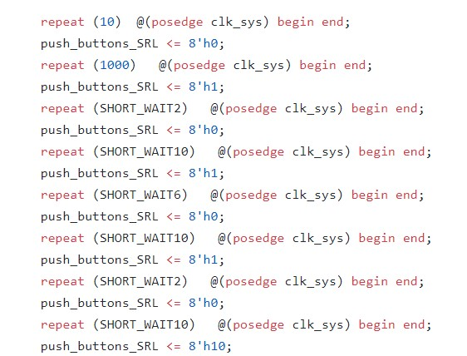
TESTBENCH
We made several tests to check the hardaware’s behaviour with some input test
In the right picture it’s represented the code of button pressing simulation. In this case we are pushing the first button to generate the signals corresponding the ‘r’ letter, and the third button to notify that we reach the end of the character

Slide 9
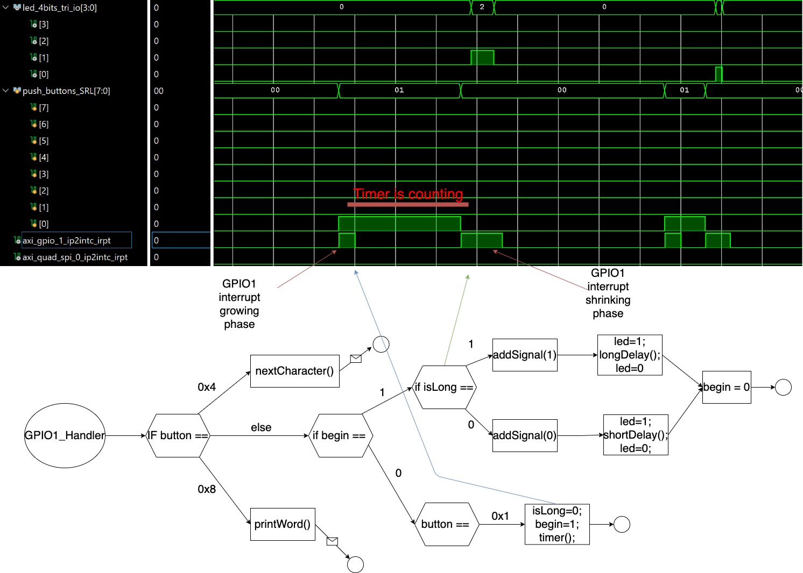
TESTBENCH

Slide 10
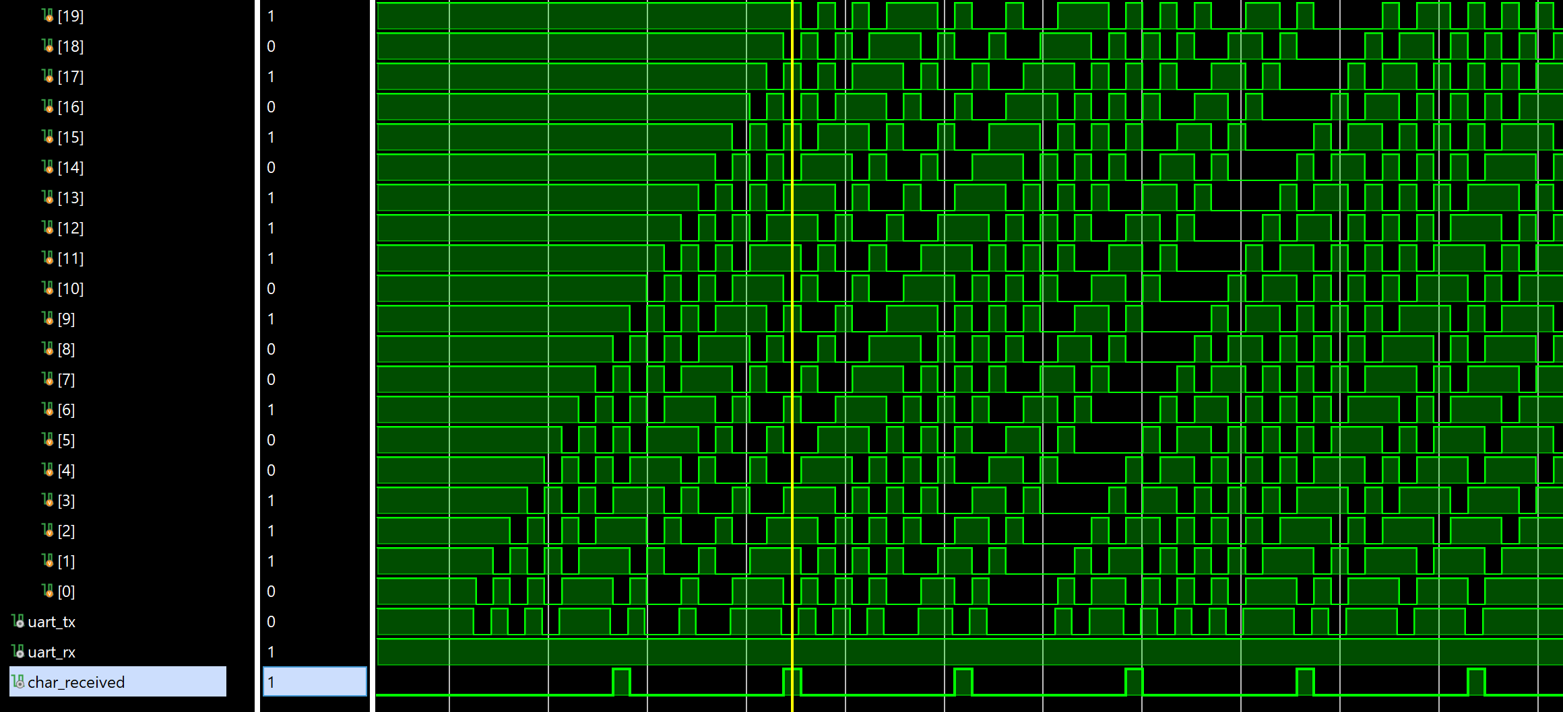
TESTBENCH
UART
The sequence of frames in the UART protocol consists of :
Start / Stop bits ➔ 0/1
Data bits ➔ binary format of character
We read the binary format of ‘u’ as the arrow says: strating from the bit before stop bit to the bit after the start bit
start 1 0 1 0 1 1 1 0 stop

Slide 12

Firma convenzione Politecnico di Milano e Veneranda Fabbrica del Duomo di Milano
Inserimento secondo logo
Fare clic per modificare lo stile del titolo
Fare clic per modificare lo stile del sottotitolo dello schema
Aula Magna – Rettorato
Mercoledì 27 maggio 2015

